Slide 1
CS-688 Machine Learning
Fang-Yi Yu
George Mason University, Fall 2025

Slide 2
Logistic
Final project group formation this Friday
Homework 2 due on Oct 21
Midterm on Oct 22

Slide 3
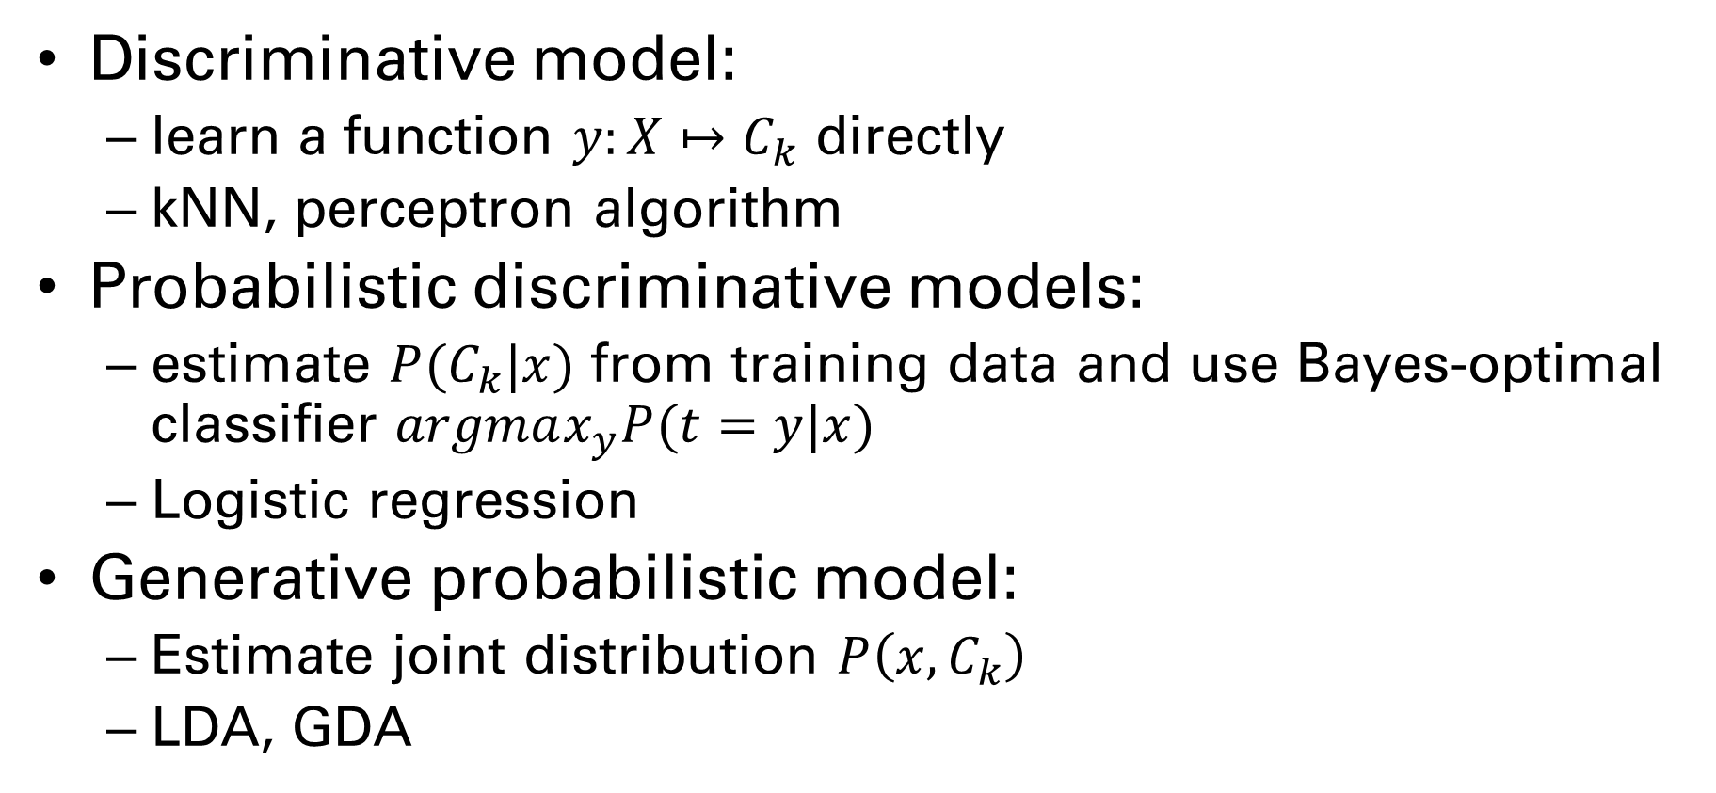
Three different approaches
Discriminative model:
learn a function $y:X↦C_{k}$ directly
kNN, perceptron algorithm
Probabilistic discriminative models:
estimate $P(C_{k}|x)$ from training data and use Bayes-optimal classifier $argmax_{y}P(t=y|x)$
Logistic regression
Generative probabilistic model:
Estimate joint distribution $P\left(x, C_{k}\right)$
LDA, GDA

Slide 4
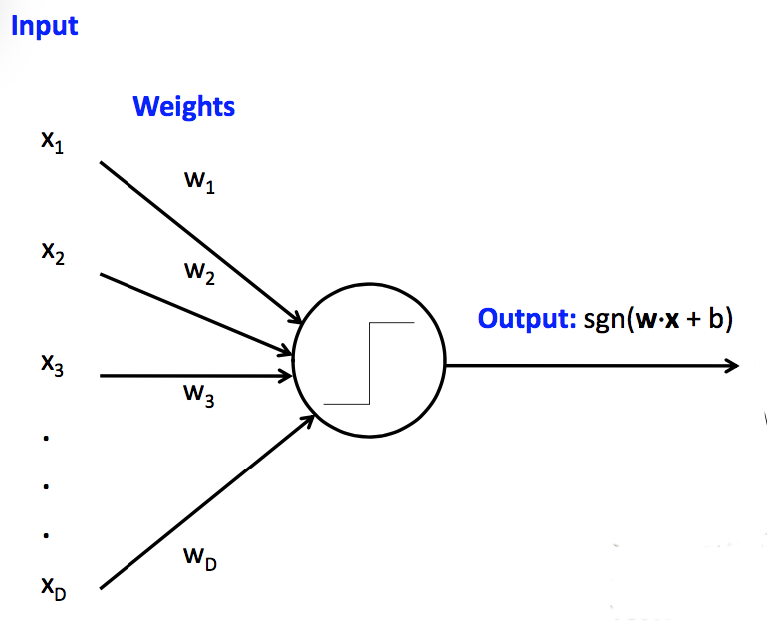

Perceptron Algorithm
Find $w$ that minimize error of linear classifier $\operatorname{sgn}{w^{t}x}$

Slide 5

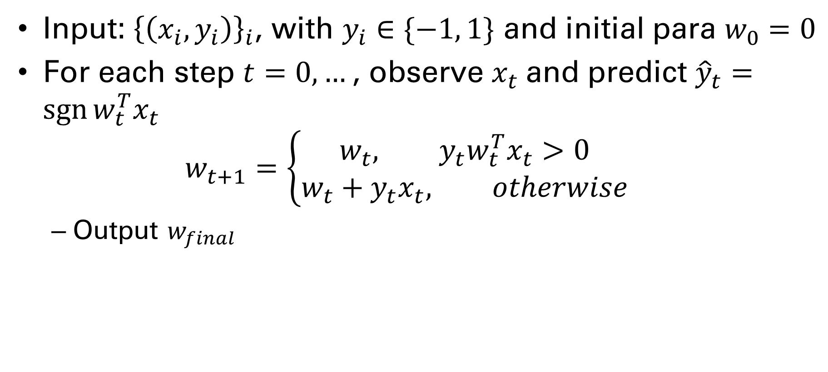
Perceptron Algorithm
Input: ${\left\{\left(x_{i}, y_{i}\right)\right\}}_{i}$, with $y_{i}∈\{−1, 1\}$ and initial para $w_{0}=0$
For each step $t=0,…$, observe $x_{t}$ and predict ${\hat{y}}_{t}=\operatorname{sgn}{w_{t}^{T}x_{t}}$ $w_{t+1}=\left\{\begin{aligned}w_{t}, {y_{t}w}_{t}^{T}x_{t}>0 \\ &w_{t}+y_{t}x_{t}, otherwise\end{aligned}\right.$
Output $w_{final}$
Correct ${\hat{y}}_{t}=y_{t}$

Slide 6
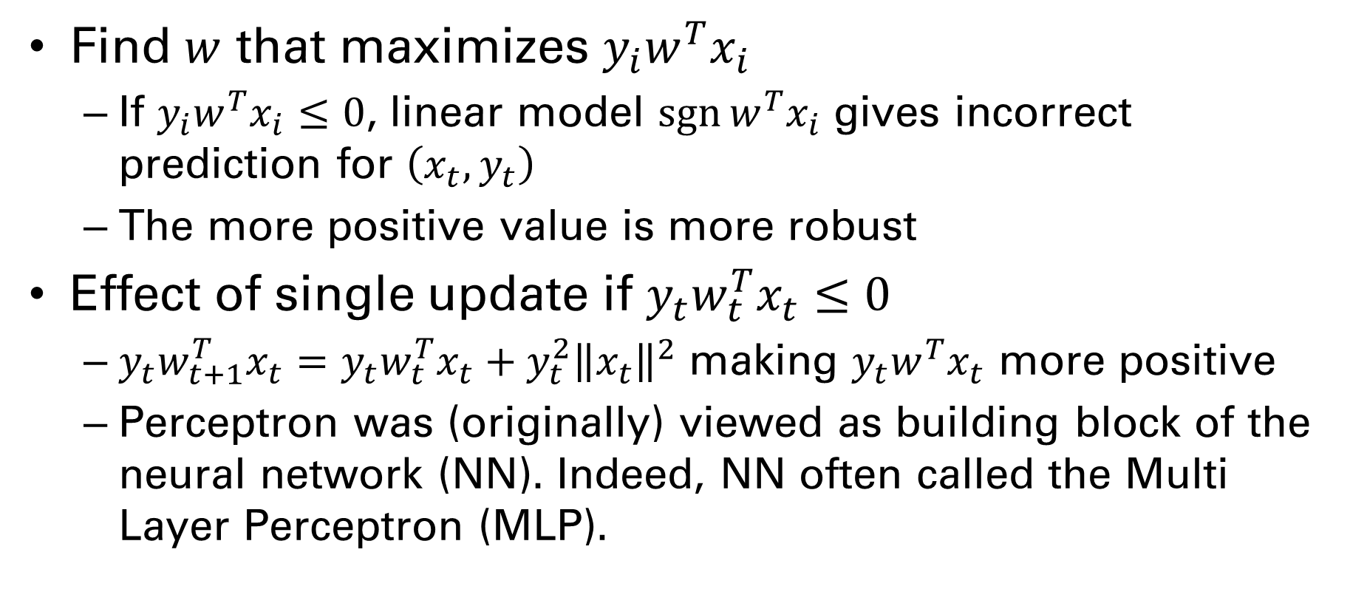
Perceptron Algorithm: Intuition
Find $w$ that maximizes $y_{i}w^{T}x_{i}$
If $y_{i}w^{T}x_{i}≤0$, linear model $\operatorname{sgn}{w^{T}x_{i}}$ gives incorrect prediction for $\left(x_{t}, y_{t}\right)$
The more positive value is more robust
Effect of single update if ${y_{t}w}_{t}^{T}x_{t}≤0$
$y_{t}w_{t+1}^{T}x_{t}=y_{t}w_{t}^{T}x_{t}+y_{t}^{2}{\left\|x_{t}\right\|}^{2}$ making $y_{t}w^{T}x_{t}$ more positive
Perceptron was (originally) viewed as building block of the neural network (NN). Indeed, NN often called the Multi Layer Perceptron (MLP).

Slide 7
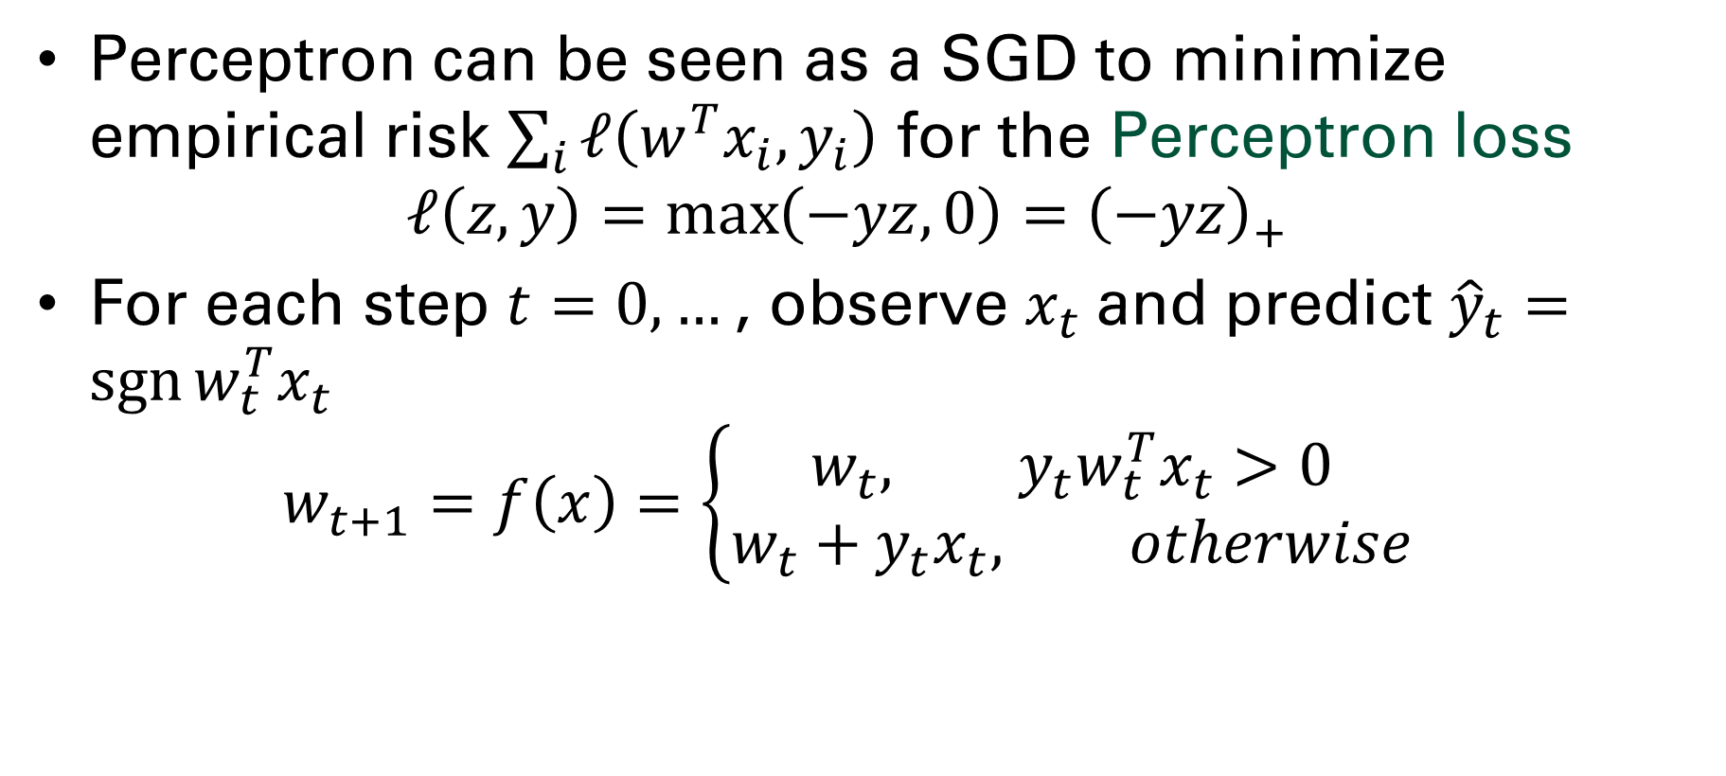
Perceptron Algorithm as SGD
Perceptron can be seen as a SGD to minimize empirical risk $\sum_{i}{ℓ\left(w^{T}x_{i}, y_{i}\right)}$ for the Perceptron loss $ℓ\left(z, y\right)=\max\left(−yz, 0\right)={\left(−yz\right)}_{+}$
For each step $t=0,…$, observe $x_{t}$ and predict ${\hat{y}}_{t}=\operatorname{sgn}{w_{t}^{T}x_{t}}$ $w_{t+1}=f\left(x\right)=\left\{\begin{aligned}w_{t}, {y_{t}w}_{t}^{T}x_{t}>0 \\ &w_{t}+y_{t}x_{t}, otherwise\end{aligned}\right.$

Slide 8
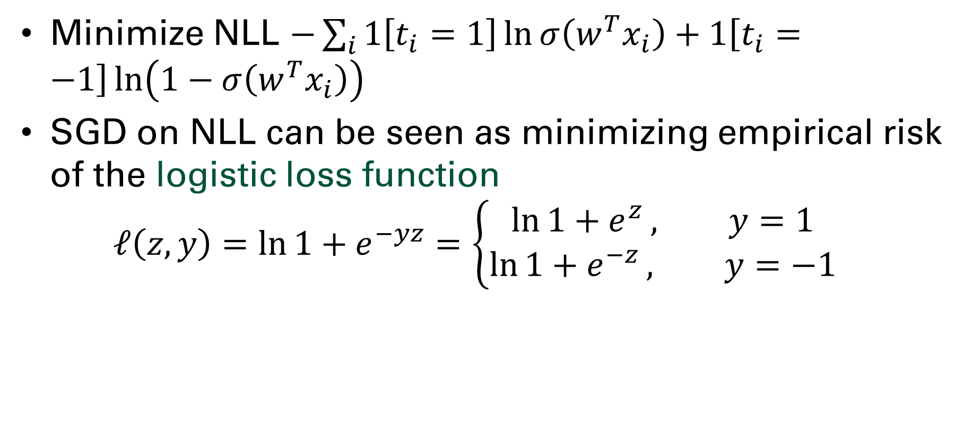
SGD logistic regression
Minimize NLL $−\sum_{i}{1\left[t_{i}=1\right]\ln{σ\left(w^{T}x_{i}\right)}+1\left[t_{i}=−1\right]\ln\left(1−σ\left(w^{T}x_{i}\right)\right)}$
SGD on NLL can be seen as minimizing empirical risk of the logistic loss function $ℓ\left(z, y\right)=\ln{1+e^{−yz}}=\left\{\begin{aligned}\ln{1+e^{z}}, y=1 \\ &\ln{1+e^{−z}}, y=−1\end{aligned}\right.$

Slide 9
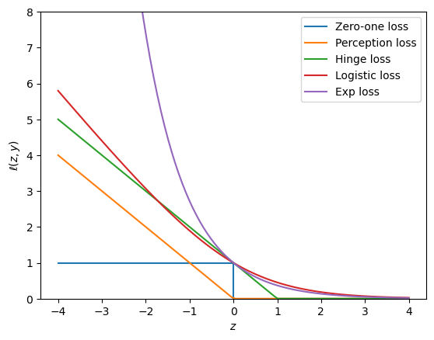
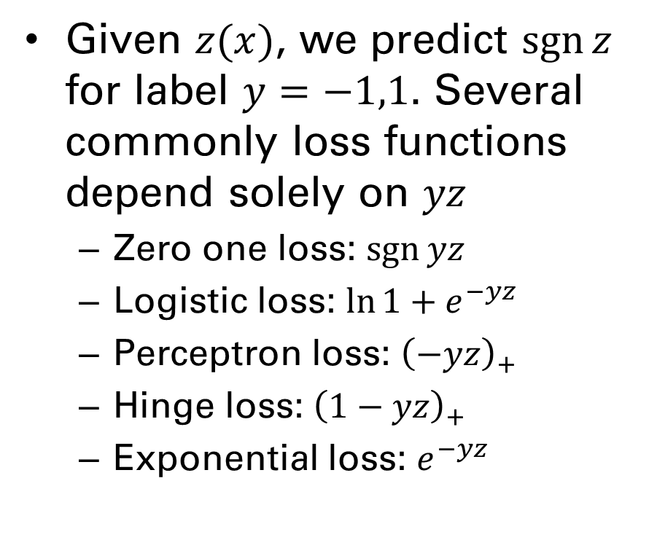
Loss functions for binary classification
Given $z(x)$, we predict $\operatorname{sgn}{z}$ for label $y=−1,1$. Several commonly loss functions depend solely on $yz$
Zero one loss: $\operatorname{sgn}{yz}$
Logistic loss: $\ln{1+e^{−yz}}$
Perceptron loss: ${\left(−yz\right)}_{+}$
Hinge loss: ${\left(1−yz\right)}_{+}$
Exponential loss: $e^{−yz}$

Slide 10
Support vector machine

Slide 11
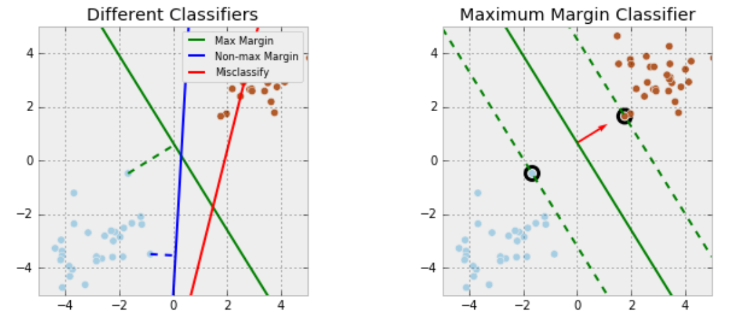
Margin classifier
Max. Margin Classifiers: separate data by looking for the hyperplane that maximizes the margin.

Slide 12
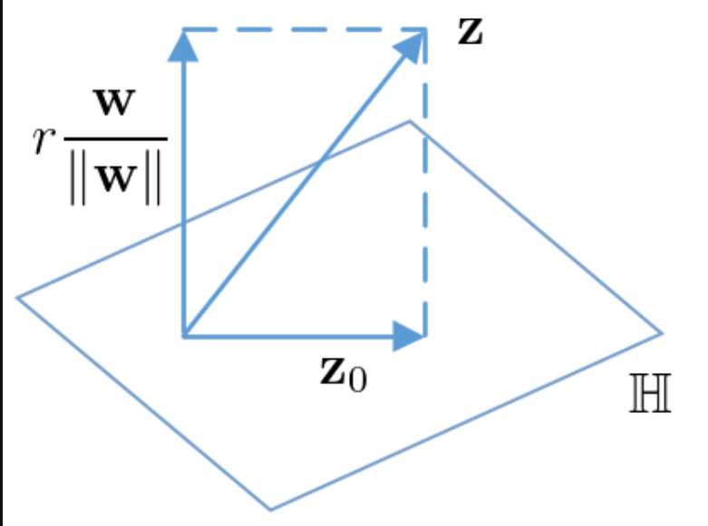
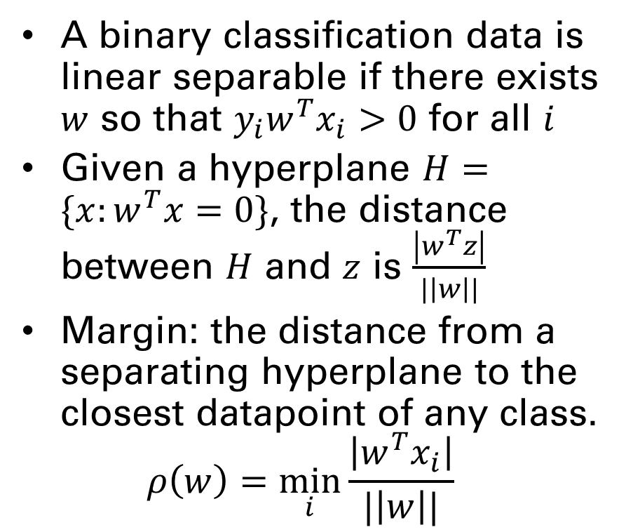
Linearly separable data and margin
A binary classification data is linear separable if there exists $w$ so that $y_{i}w^{T}x_{i}>0$ for all $i$
Given a hyperplane $H=\{x:w^{T}x=0\}$, the distance between $H$ and $z$ is $\frac{\left|w^{T}z\right|}{|\left|w\right||}$
Margin: the distance from a separating hyperplane to the closest datapoint of any class. $ρ\left(w\right)=\min_{i}{\frac{\left|w^{T}x_{i}\right|}{|\left|w\right||}}$

Slide 13
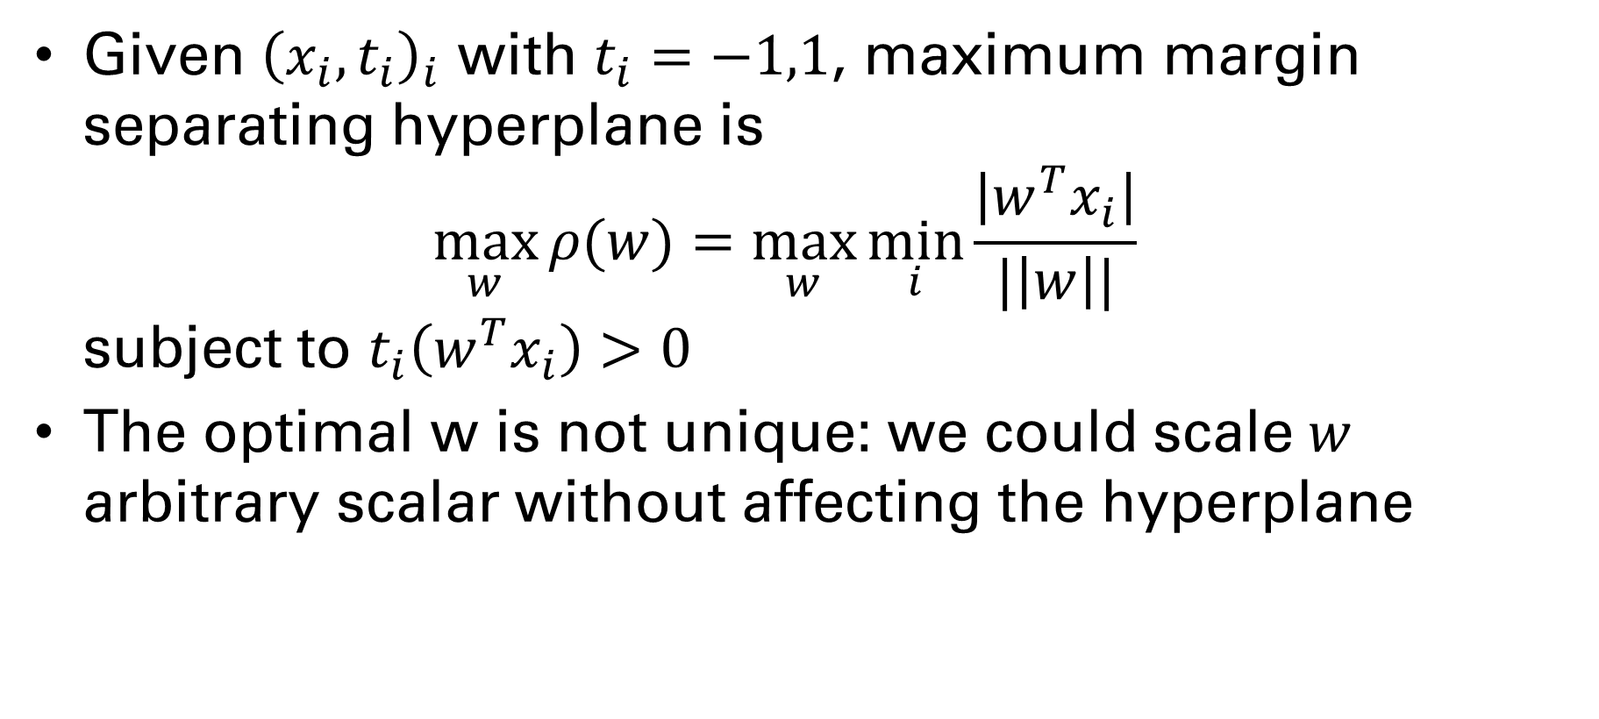
Finding the Max-Margin Hyperplane
Given ${\left(x_{i}, t_{i}\right)}_{i}$ with $t_{i}=−1,1$, maximum margin separating hyperplane is $\max_{w}{ρ(w)}=\max_{w}{\min_{i}{\frac{\left|w^{T}x_{i}\right|}{|\left|w\right||}}}$ subject to $t_{i}\left(w^{T}x_{i}\right)>0$
The optimal w is not unique: we could scale $w$ arbitrary scalar without affecting the hyperplane

Slide 14
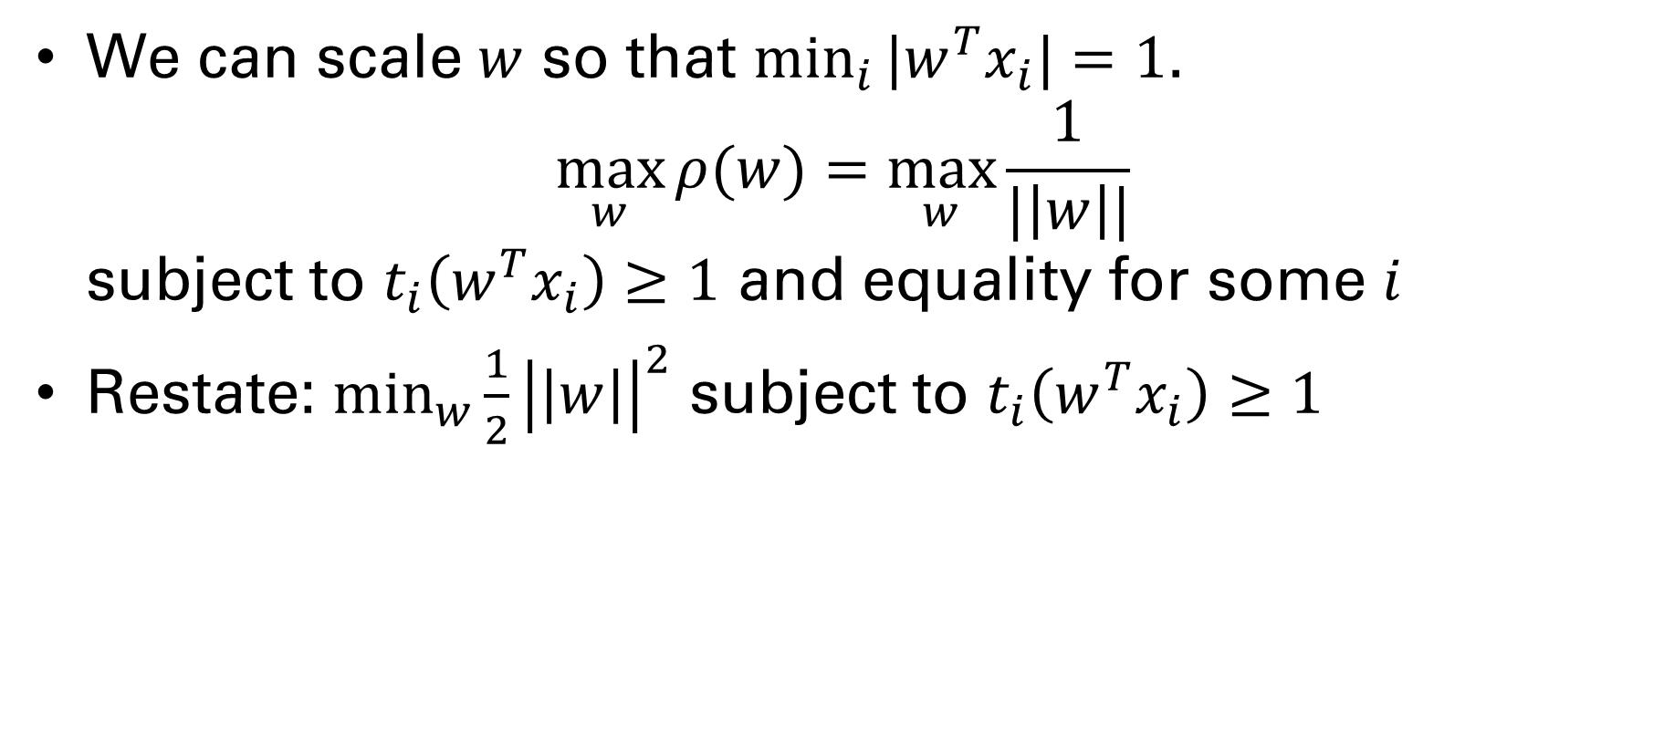
Optimal margin hyperplane (OMH)
We can scale $w$ so that $\min_{i}{|w^{T}x_{i}|}=1$. $\max_{w}{ρ(w)}=\max_{w}{\frac{1}{|\left|w\right||}}$ subject to $t_{i}\left(w^{T}x_{i}\right)≥1$ and equality for some $i$
Restate: $\min_{w}{\frac{1}{2}{\left|\left|w\right|\right|}^{2}}$ subject to $t_{i}\left(w^{T}x_{i}\right)≥1$
Constrained convex optimization problem!!

Slide 15
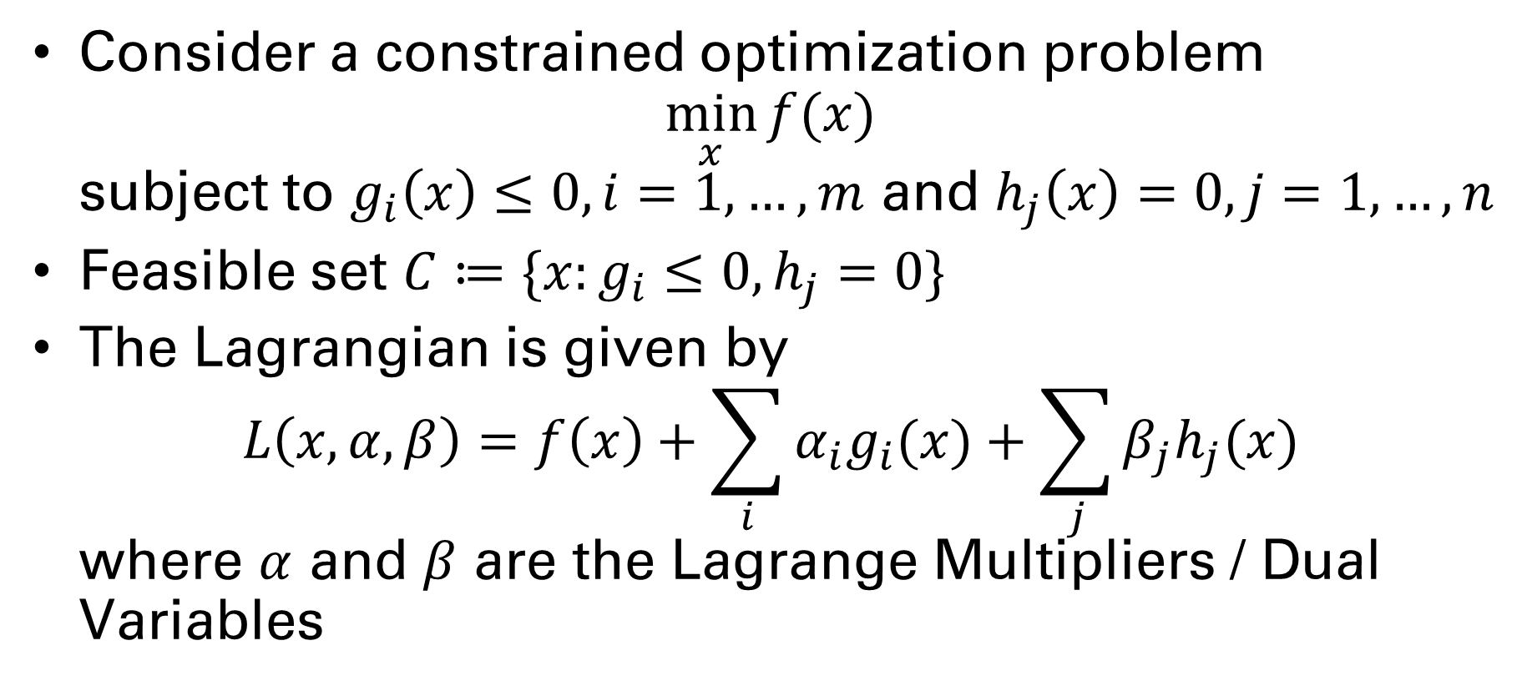
Constrained optimization
Consider a constrained optimization problem $\min_{x}{f(x)}$ subject to $g_{i}\left(x\right)≤0, i=1,…,m$ and $h_{j}\left(x\right)=0, j=1,…,n$
Feasible set $C≔\{x:g_{i}≤0, h_{j}=0\}$
The Lagrangian is given by $L\left(x,α, β\right)=f\left(x\right)+\sum_{i}{α_{i}g_{i}(x)}+\sum_{j}{β_{j}h_{j}(x)}$ where $α$ and $β$ are the Lagrange Multipliers / Dual Variables

Slide 16
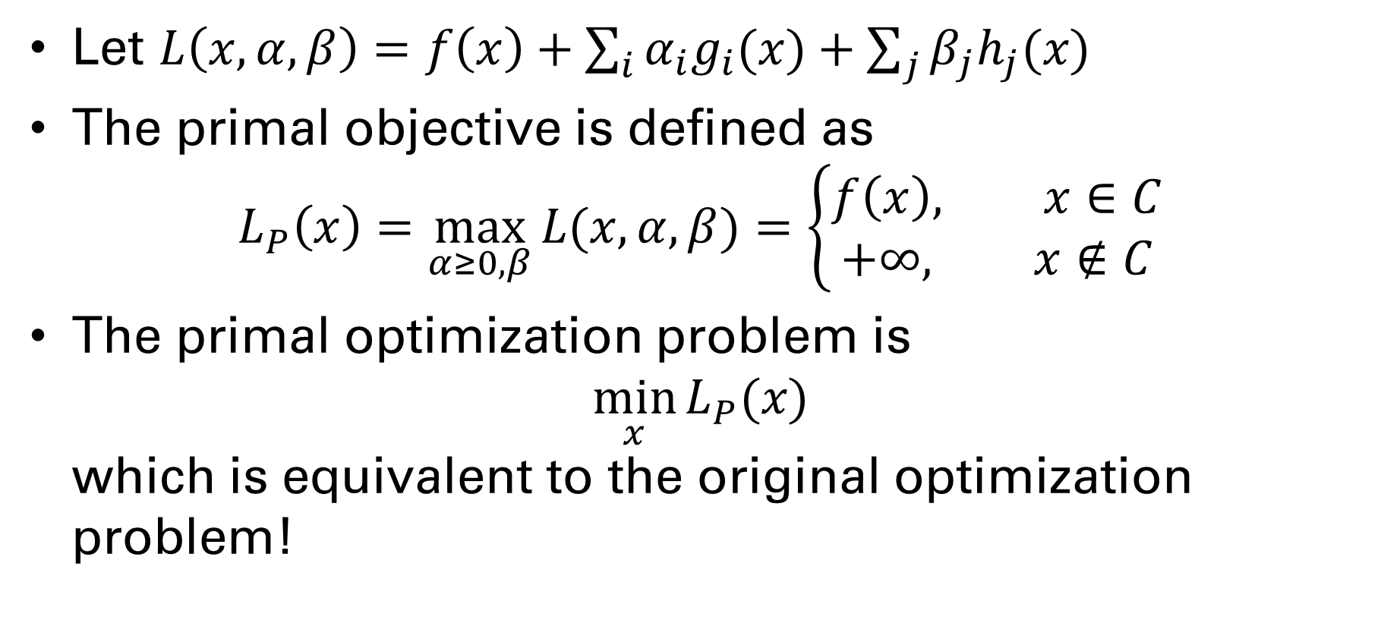
Lagrangian Primal
Let $L\left(x,α, β\right)=f\left(x\right)+\sum_{i}{α_{i}g_{i}(x)}+\sum_{j}{β_{j}h_{j}(x)}$
The primal objective is defined as $L_{P}\left(x\right)=\max_{α≥0, β}{L(x,α, β)}=\left\{\begin{aligned}f\left(x\right), x∈C \\ &+∞, x∉C\end{aligned}\right.$
The primal optimization problem is $\min_{x}{L_{P}(x)}$ which is equivalent to the original optimization problem!

Slide 17
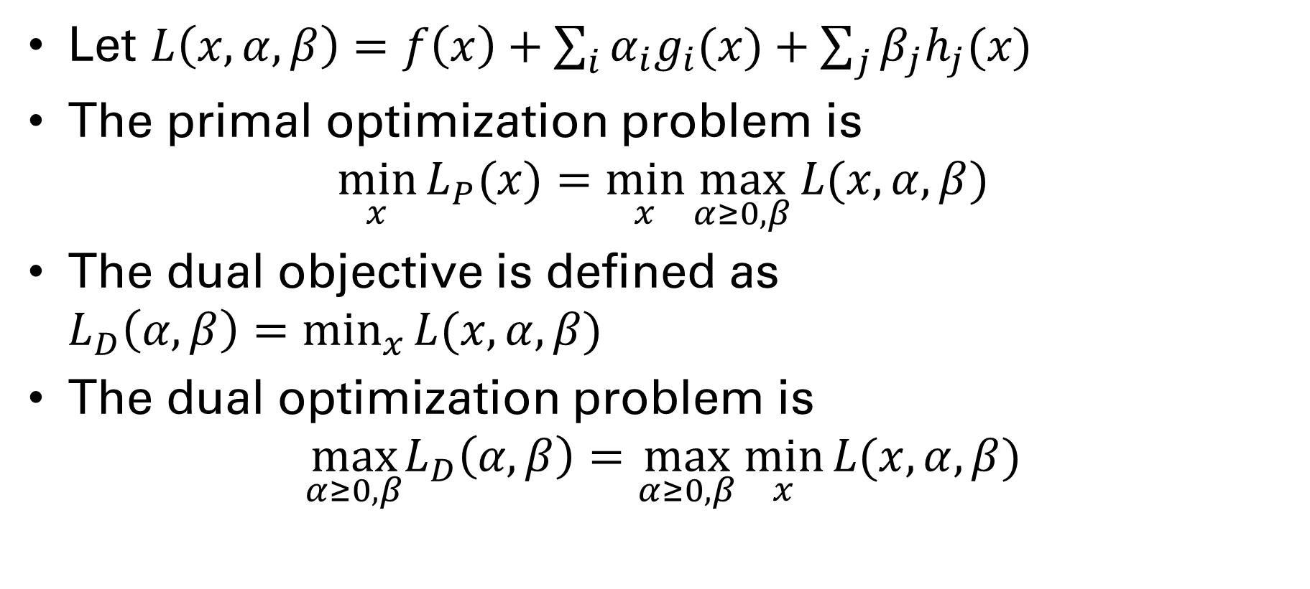
Lagrangian Dual
Let $L\left(x,α, β\right)=f\left(x\right)+\sum_{i}{α_{i}g_{i}(x)}+\sum_{j}{β_{j}h_{j}(x)}$
The primal optimization problem is $\min_{x}{L_{P}(x)}=\min_{x}{\max_{α≥0, β}{L(x, α, β)}}$
The dual objective is defined as $L_{D}\left(α, β\right)=\min_{x}{L(x,α, β)}$
The dual optimization problem is $\max_{α≥0, β}L_{D}\left(α, β\right)=\max_{α≥0, β}{\min_{x}{L(x, α, β)}}$

Slide 18
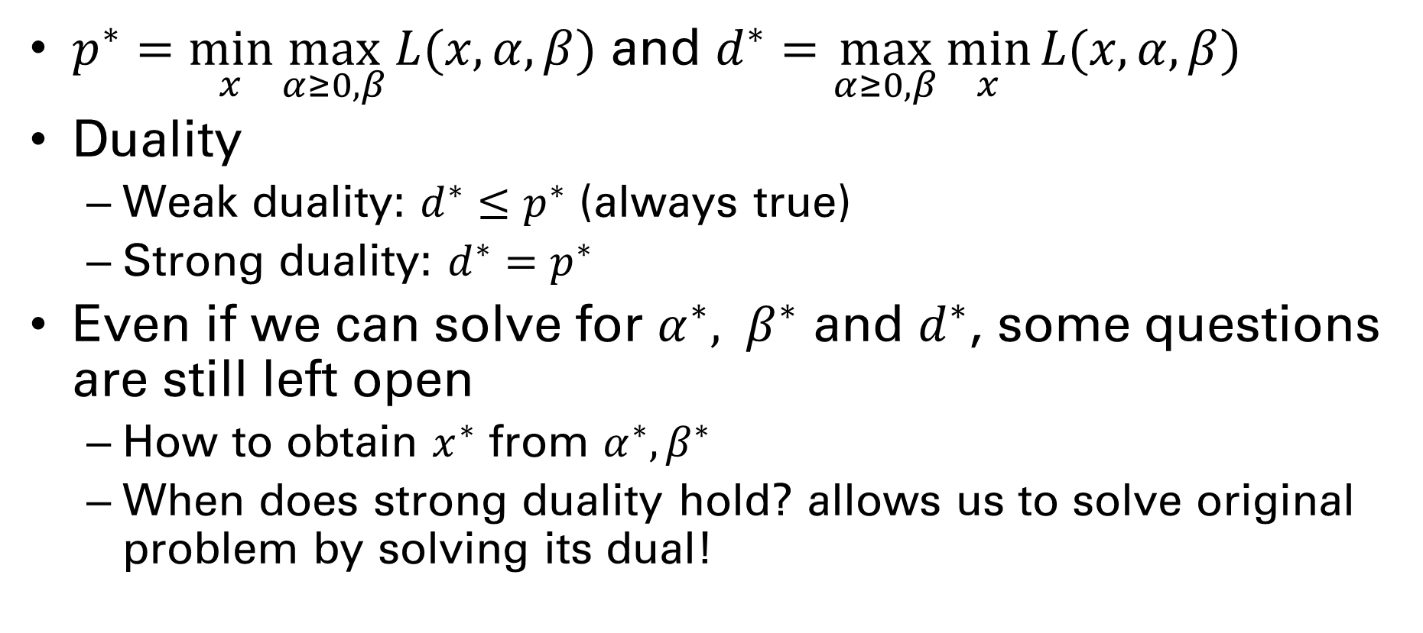
Strong and Weak Duality
$p^{∗}=\min_{x}{\max_{α≥0, β}{L(x, α, β)}}$ and $d^{∗}=\max_{α≥0, β}{\min_{x}{L(x, α, β)}}$
Duality
Weak duality: $d^{∗}≤p^{∗}$ (always true)
Strong duality: $d^{∗}=p^{∗}$
Even if we can solve for $α^{∗}, β^{∗}$ and $d^{∗}$, some questions are still left open
How to obtain $x^{∗}$ from $α^{∗}, β^{∗}$
When does strong duality hold? allows us to solve original problem by solving its dual!

Slide 19
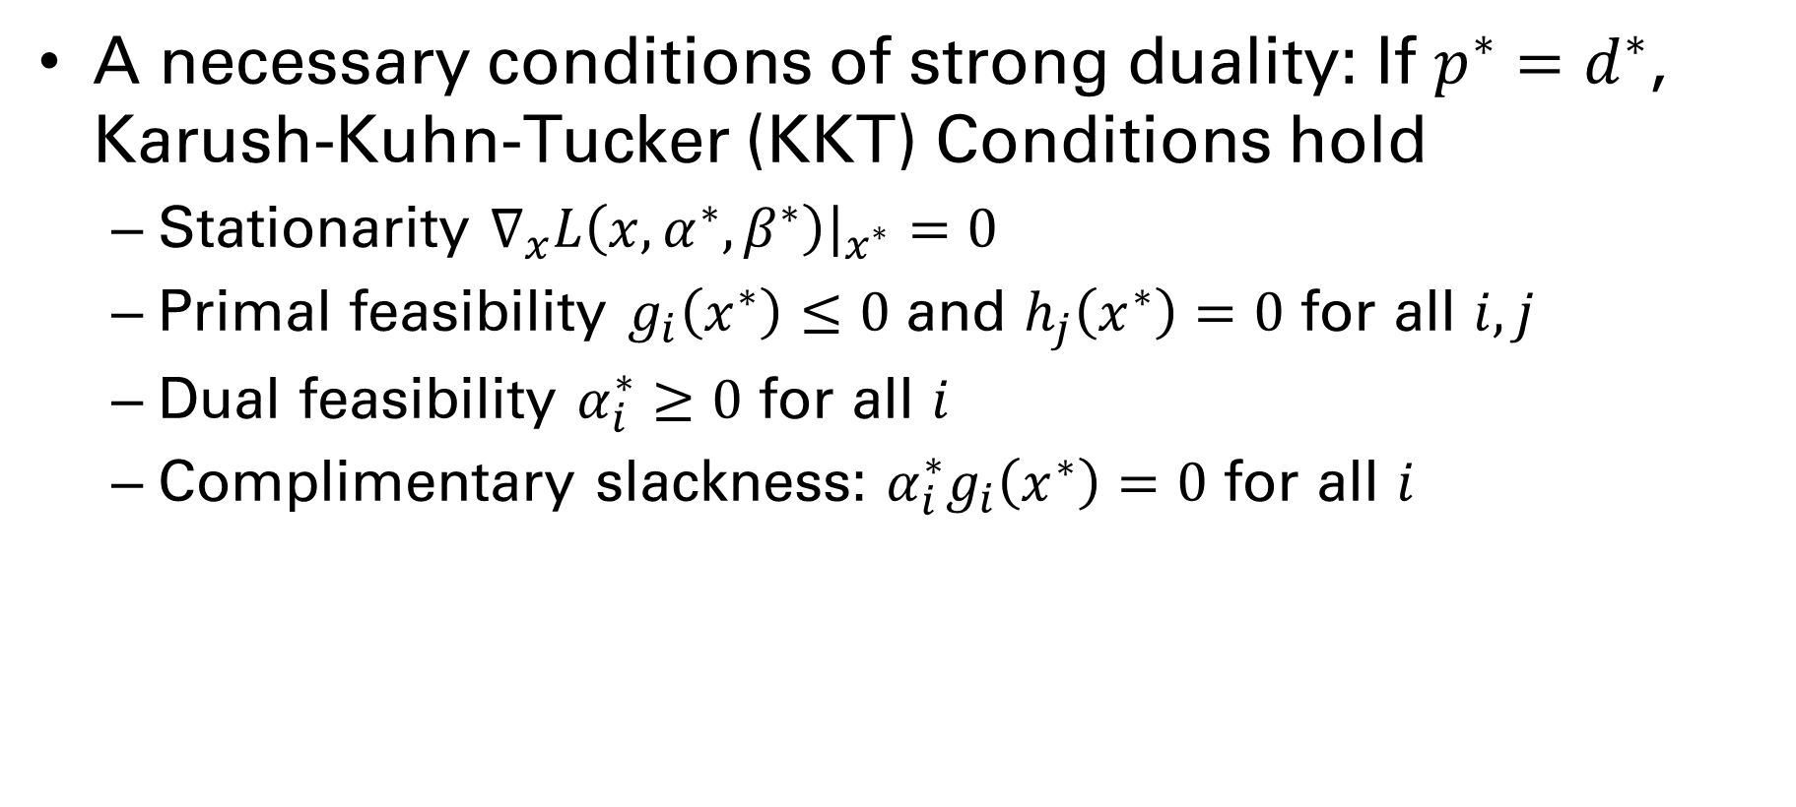
Strong Duality—KKT Conditions
A necessary conditions of strong duality: If $p^{∗}=d^{∗}$, Karush-Kuhn-Tucker (KKT) Conditions hold
Stationarity $∇_{x}L\left(x,α^{∗}, β^{∗}\right){\left.​\right|}_{x^{∗}}=0$
Primal feasibility $g_{i}\left(x^{∗}\right)≤0$ and $h_{j}\left(x^{∗}\right)=0$ for all $i,j$
Dual feasibility $α_{i}^{∗}≥0$ for all $i$
Complimentary slackness: $α_{i}^{∗}g_{i}\left(x^{∗}\right)=0$ for all $i$
Stephen Boyd and Lieven Vandenberghe. Convex Optimization. Cambridge UP, 2004. Online: http://www.stanford.edu/~boyd/cvxbook/

Slide 20
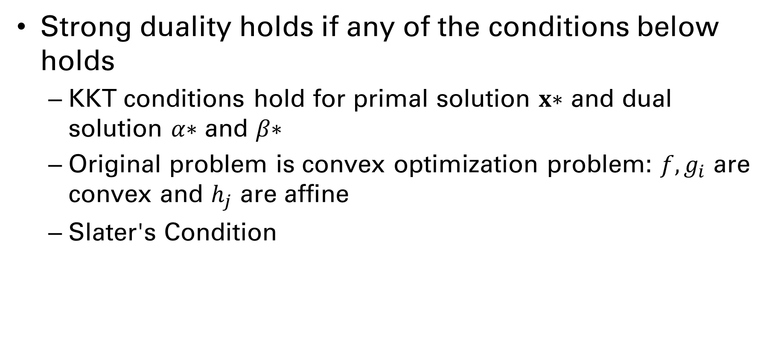
Sufficient Conditions of Strong Duality
Strong duality holds if any of the conditions below holds
KKT conditions hold for primal solution 𝐱∗ and dual solution 𝛼∗ and 𝛽∗
Original problem is convex optimization problem: $f, g_{i}$ are convex and $h_{j}$ are affine
Slater's Condition

Slide 21
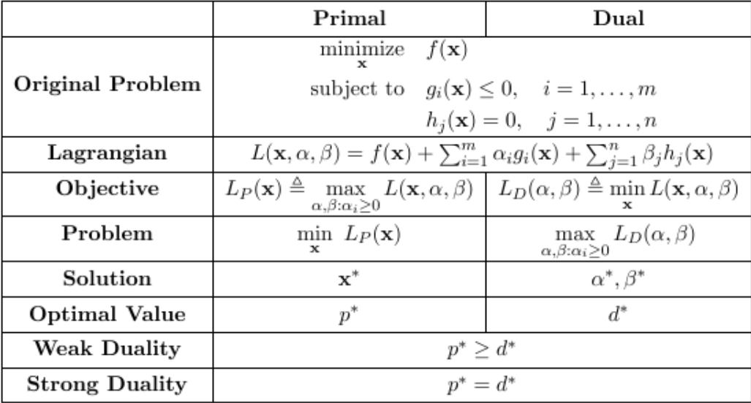
A Quick Summary

Slide 22
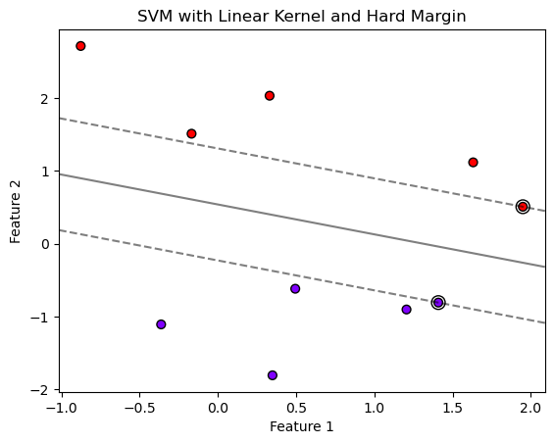
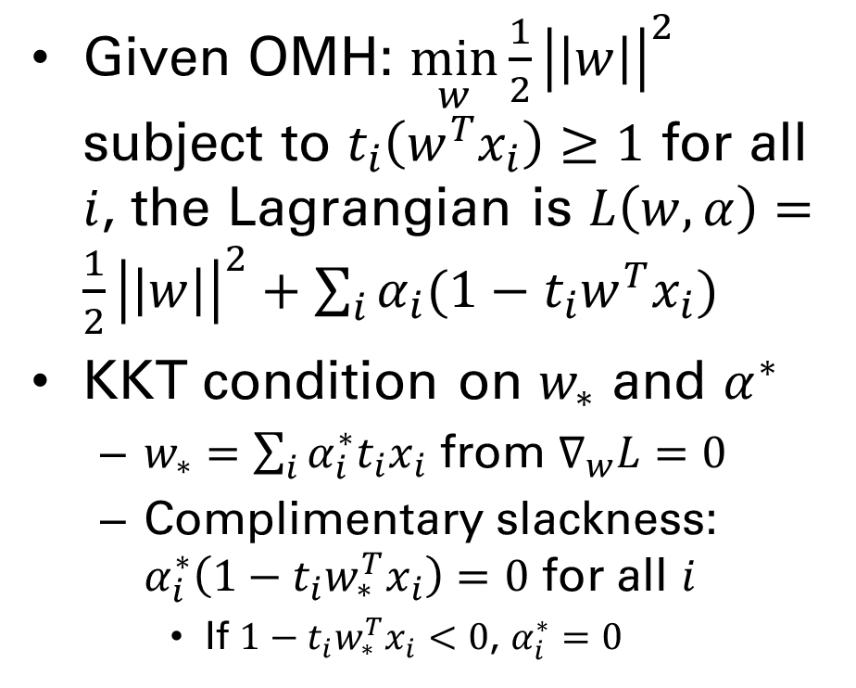
OMH and Lagrangian
Given OMH: $\min_{w}{\frac{1}{2}{\left|\left|w\right|\right|}^{2}}$ subject to $t_{i}\left(w^{T}x_{i}\right)≥1$ for all $i$, the Lagrangian is $L\left(w,α\right)=\frac{1}{2}{\left|\left|w\right|\right|}^{2}+\sum_{i}{α_{i}(1−t_{i}w^{T}x_{i})}$
KKT condition on $w_{∗}$ and $α^{∗}$
$w_{∗}=\sum_{i}{α_{i}^{∗}t_{i}x_{i}}$ from $∇_{w}L=0$
Complimentary slackness: $α_{i}^{∗}\left(1−t_{i}w_{∗}^{T}x_{i}\right)=0$ for all $i$
If $1−t_{i}w_{∗}^{T}x_{i}<0$, $α_{i}^{∗}=0$

Slide 23
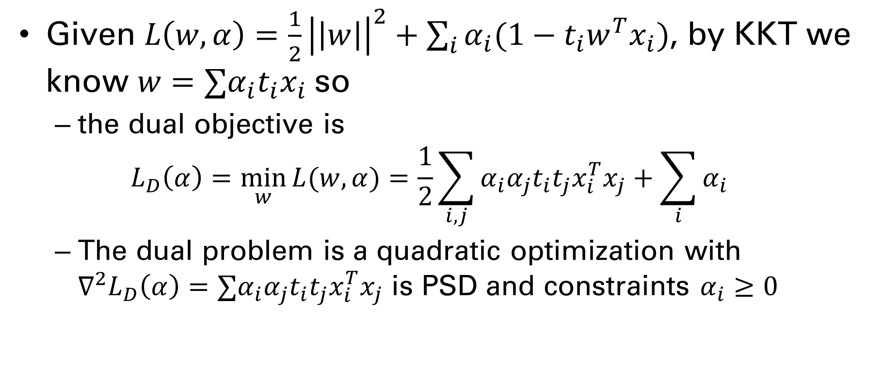
Dual Objective
Given $L\left(w,α\right)=\frac{1}{2}{\left|\left|w\right|\right|}^{2}+\sum_{i}{α_{i}(1−t_{i}w^{T}x_{i})}$, by KKT we know $w=∑α_{i}t_{i}x_{i}$ so
the dual objective is $L_{D}\left(α\right)=\min_{w}{L(w,α)}=\frac{1}{2}\sum_{i,j}{α_{i}α_{j}t_{i}t_{j}x_{i}^{T}x_{j}}+\sum_{i}{α_{i}}$
The dual problem is a quadratic optimization with $∇^{2}L_{D}\left(α\right)=∑α_{i}α_{j}t_{i}t_{j}x_{i}^{T}x_{j}$ is PSD and constraints $α_{i}≥0$

Slide 24
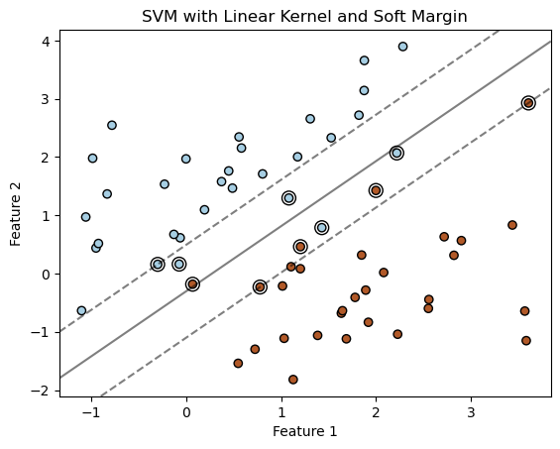
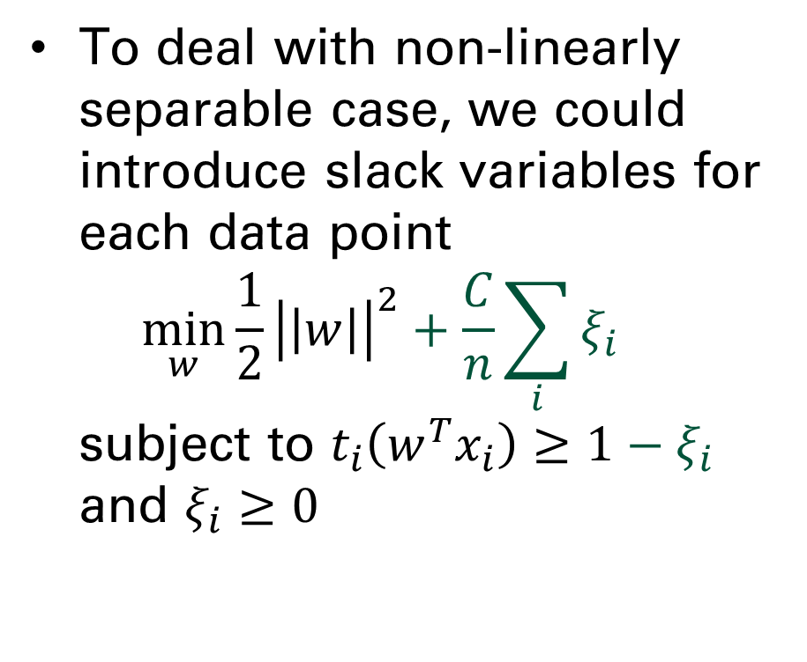
Optimal Soft-Margin Hyperplane (OSMH)
To deal with non-linearly separable case, we could introduce slack variables for each data point $\min_{w}{\frac{1}{2}{\left|\left|w\right|\right|}^{2}}+\frac{C}{n}\sum_{i}{ξ_{i}}$ subject to $t_{i}\left(w^{T}x_{i}\right)≥1−ξ_{i}$ and $ξ_{i}≥0$

Slide 25
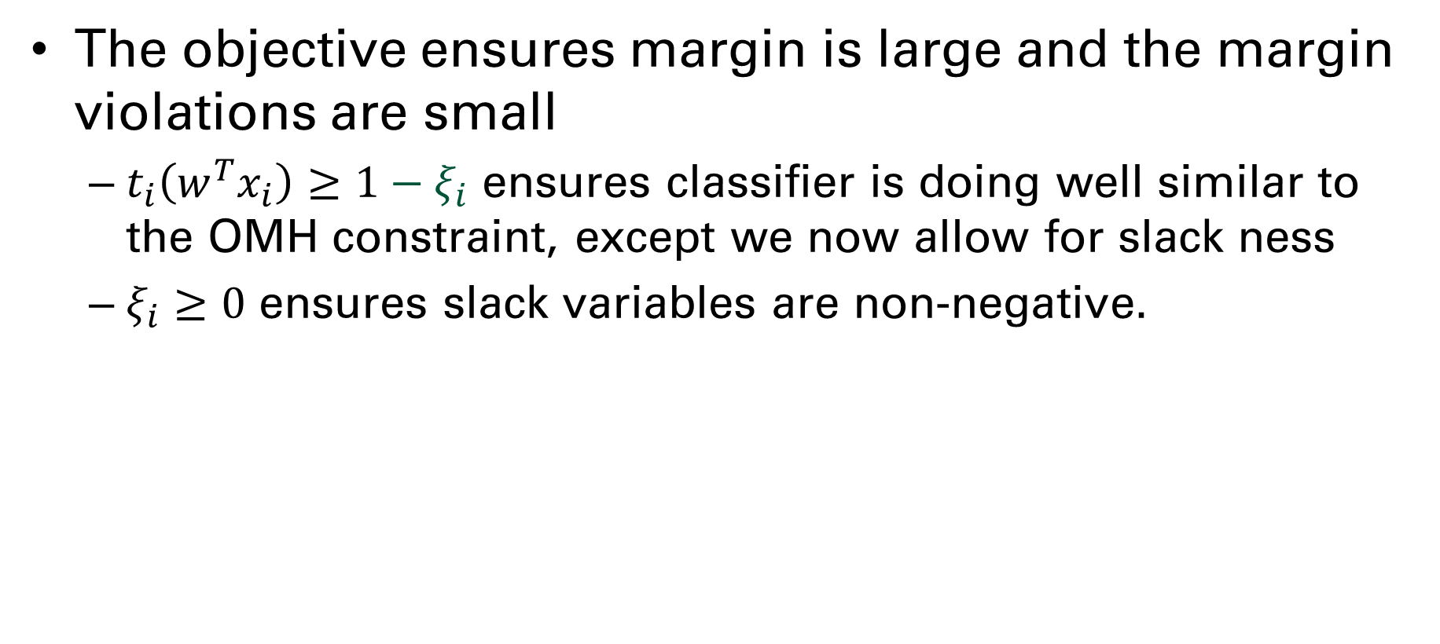
Motivation for OSMH
The objective ensures margin is large and the margin violations are small
$t_{i}\left(w^{T}x_{i}\right)≥1−ξ_{i}$ ensures classifier is doing well similar to the OMH constraint, except we now allow for slack ness
$ξ_{i}≥0$ ensures slack variables are non-negative.

Slide 26
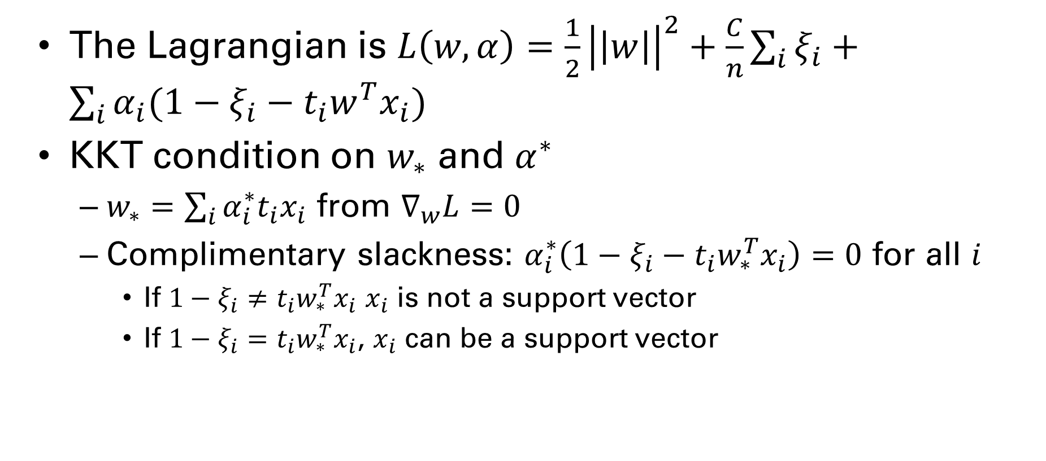
Solving OSMH
The Lagrangian is $L\left(w,α\right)=\frac{1}{2}{\left|\left|w\right|\right|}^{2}+\frac{C}{n}\sum_{i}{ξ_{i}}+\sum_{i}{α_{i}(1−ξ_{i}−t_{i}w^{T}x_{i})}$
KKT condition on $w_{∗}$ and $α^{∗}$
$w_{∗}=\sum_{i}{α_{i}^{∗}t_{i}x_{i}}$ from $∇_{w}L=0$
Complimentary slackness: $α_{i}^{∗}\left(1−ξ_{i}−t_{i}w_{∗}^{T}x_{i}\right)=0$ for all $i$
If $1−ξ_{i}≠t_{i}w_{∗}^{T}x_{i}$ $x_{i}$ is not a support vector
If $1−ξ_{i}=t_{i}w_{∗}^{T}x_{i}$, $x_{i}$ can be a support vector

Slide 27
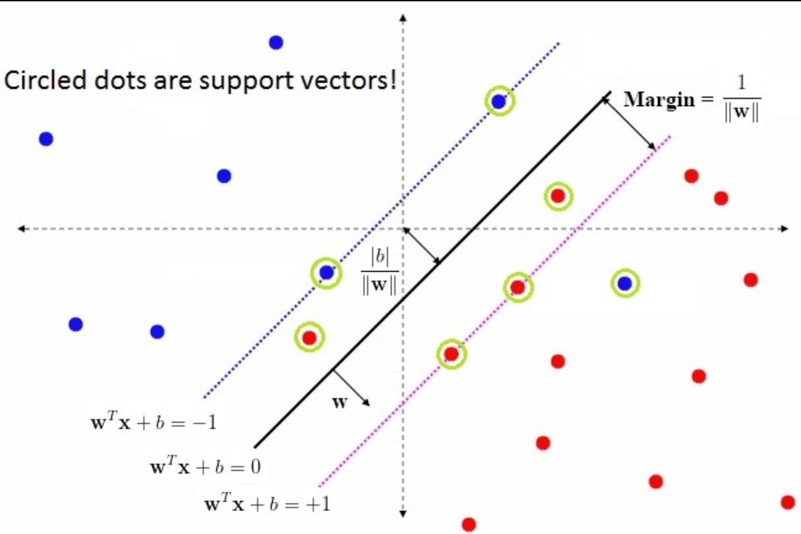
Support vector

Slide 28
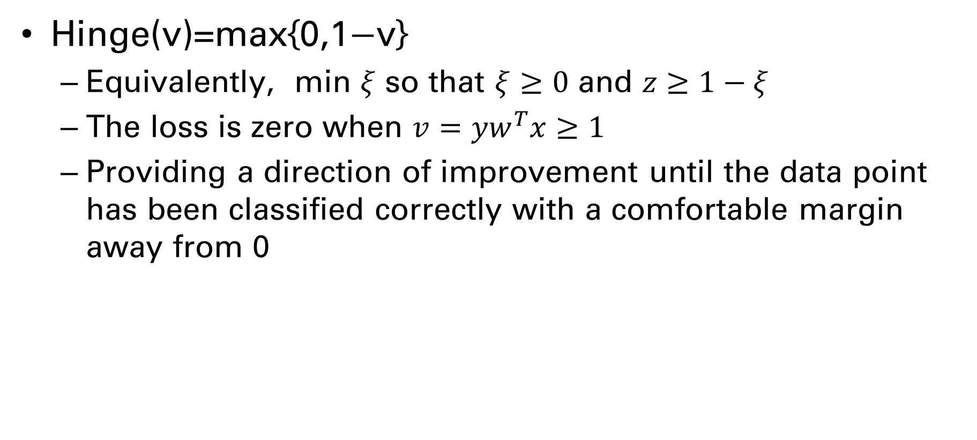
Hinge loss
Hinge(v)=max{0,1−v}
Equivalently, min $ξ$ so that $ξ≥0$ and $z≥1−ξ$
The loss is zero when $v=yw^{T}x≥1$
Providing a direction of improvement until the data point has been classified correctly with a comfortable margin away from 0

Slide 29
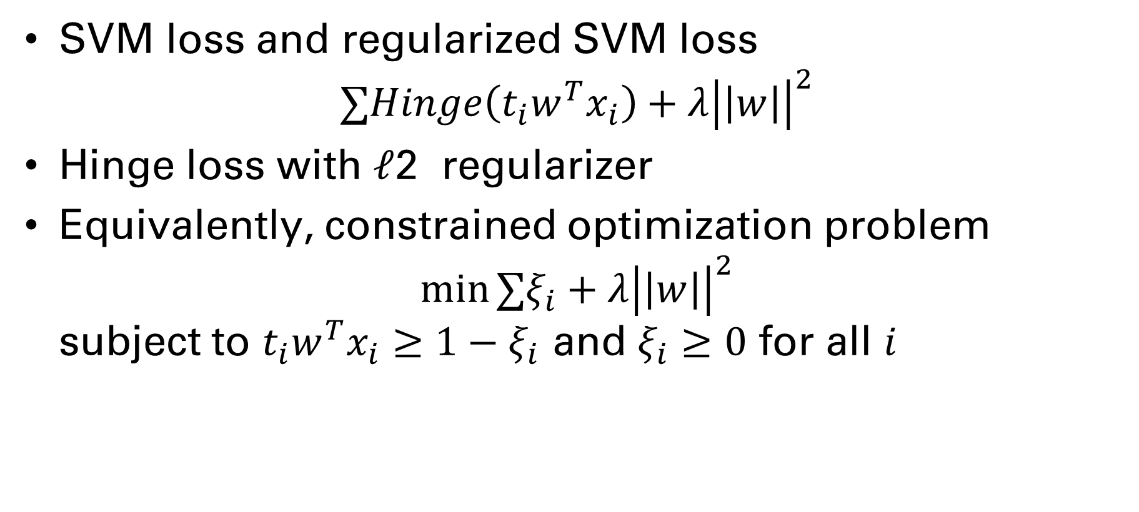
SVM algorithm
SVM loss and regularized SVM loss $∑Hinge\left(t_{i}w^{T}x_{i}\right)+λ{\left|\left|w\right|\right|}^{2}$
Hinge loss with ℓ2 regularizer
Equivalently, constrained optimization problem $\min{∑ξ_{i}+λ{\left|\left|w\right|\right|}^{2}}$ subject to $t_{i}w^{T}x_{i}≥1−ξ_{i}$ and $ξ_{i}≥0$ for all $i$

Slide 30
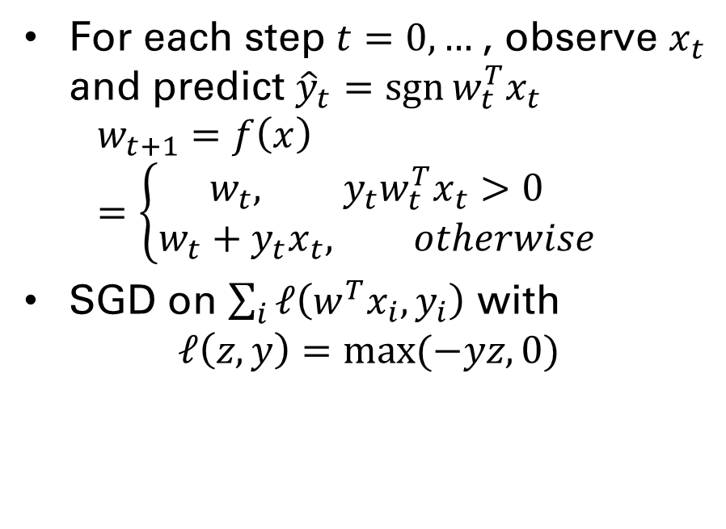

Perceptron Algorithm as ERM
SGD on logistic regression
SGD on some error function
For each step $t=0,…$, choose a learning rate $η_{t}$ and set $w_{t+1}=w_{t}−η_{t}\left(σ(w_{t}^{T}x_{t})−y_{t}\right)x_{t}$
For each step $t=0,…$, observe $x_{t}$ and predict ${\hat{y}}_{t}=\operatorname{sgn}{w_{t}^{T}x_{t}}$ $w_{t+1}=f\left(x\right)=\left\{\begin{aligned}w_{t}, {y_{t}w}_{t}^{T}x_{t}>0 \\ &w_{t}+y_{t}x_{t}, otherwise\end{aligned}\right.$
SGD on $\sum_{i}{ℓ\left(w^{T}x_{i}, y_{i}\right)}$ with $ℓ\left(z, y\right)=\max{(−yz, 0)}$

Slide 31
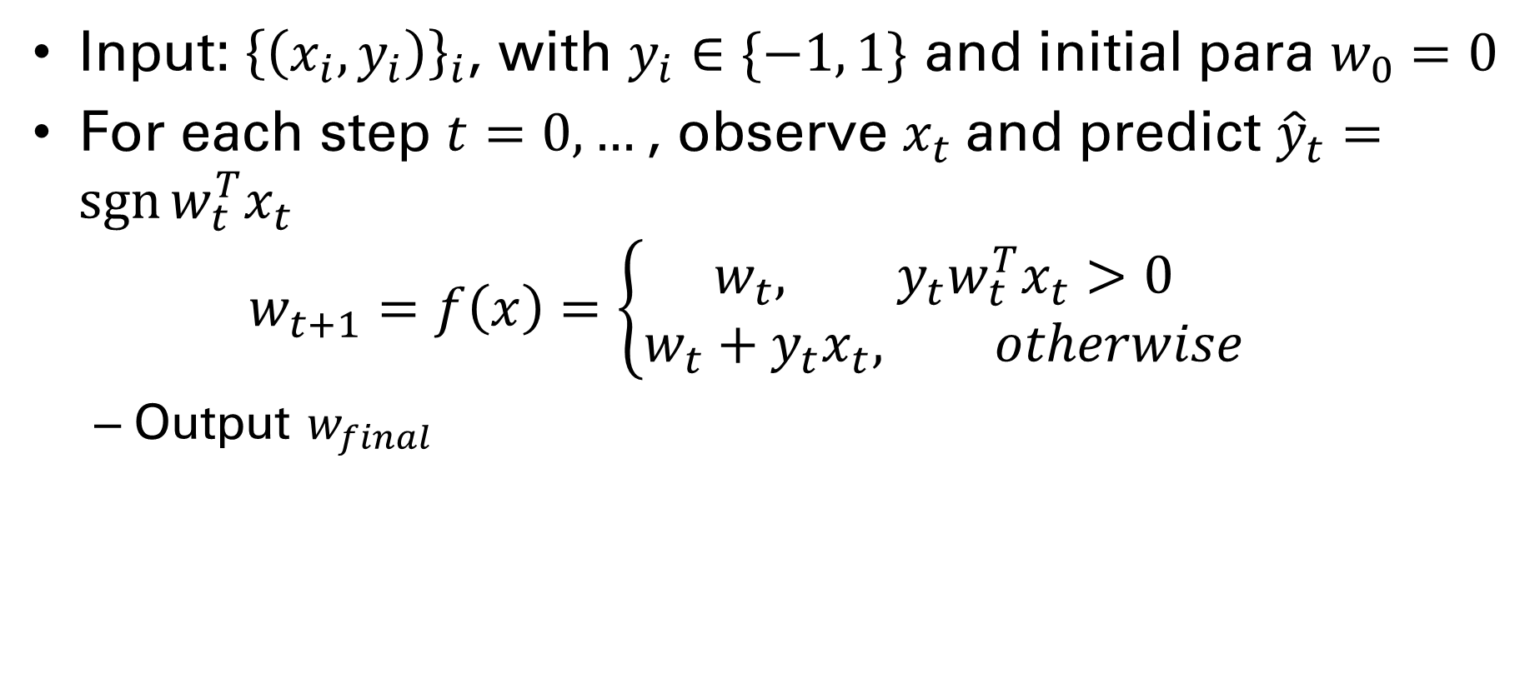
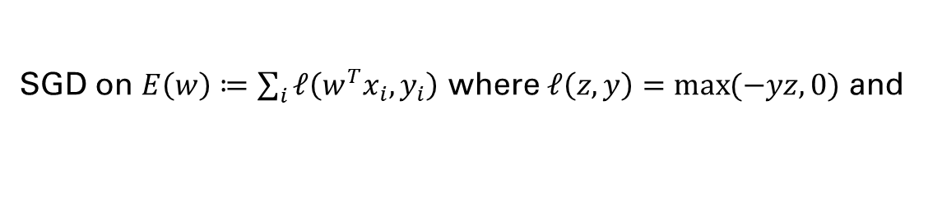
Perceptron Algorithm
Input: ${\left\{\left(x_{i}, y_{i}\right)\right\}}_{i}$, with $y_{i}∈\{−1, 1\}$ and initial para $w_{0}=0$
For each step $t=0,…$, observe $x_{t}$ and predict ${\hat{y}}_{t}=\operatorname{sgn}{w_{t}^{T}x_{t}}$ $w_{t+1}=f\left(x\right)=\left\{\begin{aligned}w_{t}, {y_{t}w}_{t}^{T}x_{t}>0 \\ &w_{t}+y_{t}x_{t}, otherwise\end{aligned}\right.$
Output $w_{final}$
Correct ${\hat{y}}_{t}=y_{t}$
SGD on $E\left(w\right)≔\sum_{i}{ℓ\left(w^{T}x_{i}, y_{i}\right)}$ where $ℓ\left(z, y\right)=\max{(−yz, 0)}$ and

Slide 32
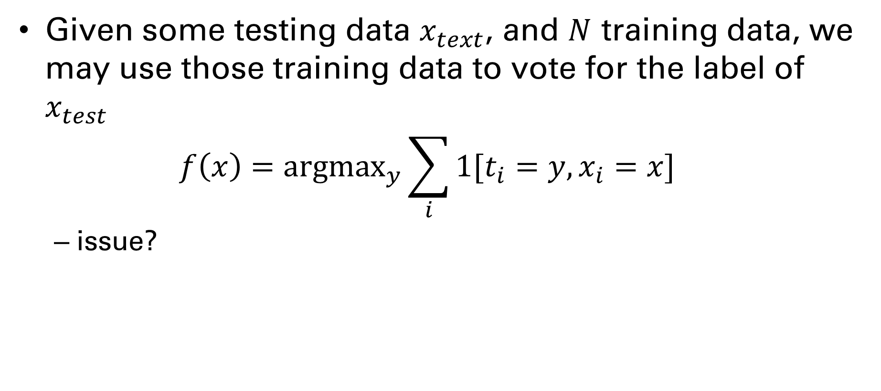
Decide on a model, Binary classification
Given some testing data $x_{text}$, and $N$ training data, we may use those training data to vote for the label of $x_{test}$ $f\left(x\right)={argmax}_{y}\sum_{i}{1[t_{i}=y,x_{i}=x]}$
issue?

Slide 33
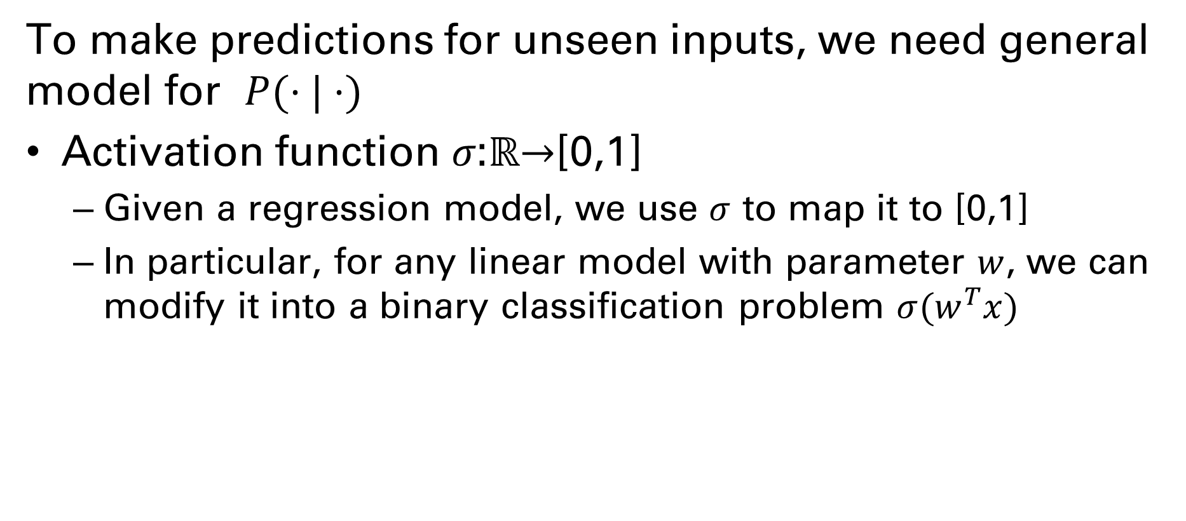
Decide on a model, Binary classification
To make predictions for unseen inputs, we need general model for $P(⋅|⋅)$
Activation function 𝜎:ℝ→[0,1]
Given a regression model, we use $σ$ to map it to [0,1]
In particular, for any linear model with parameter $w$, we can modify it into a binary classification problem $σ(w^{T}x)$

